Slide 1
Introduction to Bioinformatics Day 4: Proteomics and Structural Bioinformatics 15th January 2026

Slide 2
Outline Day 4
Morning (9-12 pm):
Proteomics
Introduction to Proteomics
Protein Interaction
Structural Proteomics
Practical Session:
Basic Proteomics Exercises
Afternoon (2-5 pm):
Structural Bioinformatics:
Practical Session:

Slide 3
Day 4: Proteomics and Structural Bioinformatics Morning Session

Slide 4
Introduction to Proteomics

Slide 5
What is a Protein?
Definition:
Essential macromolecules in all living organisms, made up of chains of amino acids (called a polypeptide). A protein contains at least one long polypeptide.
Where we find proteins?
Cells and body tissues, hormones, antibodies, and enzymes.

Slide 6
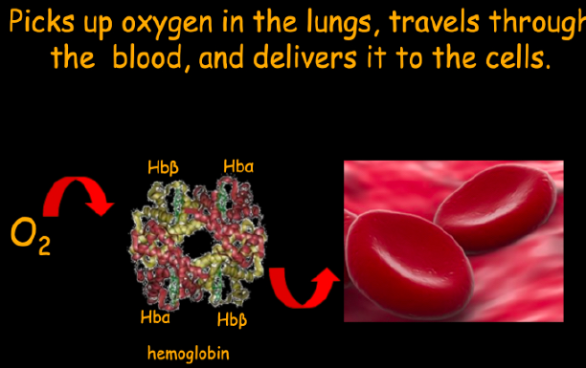
Key Functions of Proteins
Structural Support:
Collagen in connective tissues.
Enzymatic Activity:
Catalysts for biochemical reactions (e.g., amylase).
Transport:
Hemoglobin carries oxygen.
Defense:
Antibodies in the immune system.
Regulation:
Hormones like insulin.
Source: https://slideplayer.com/slide/7042803/

Slide 7
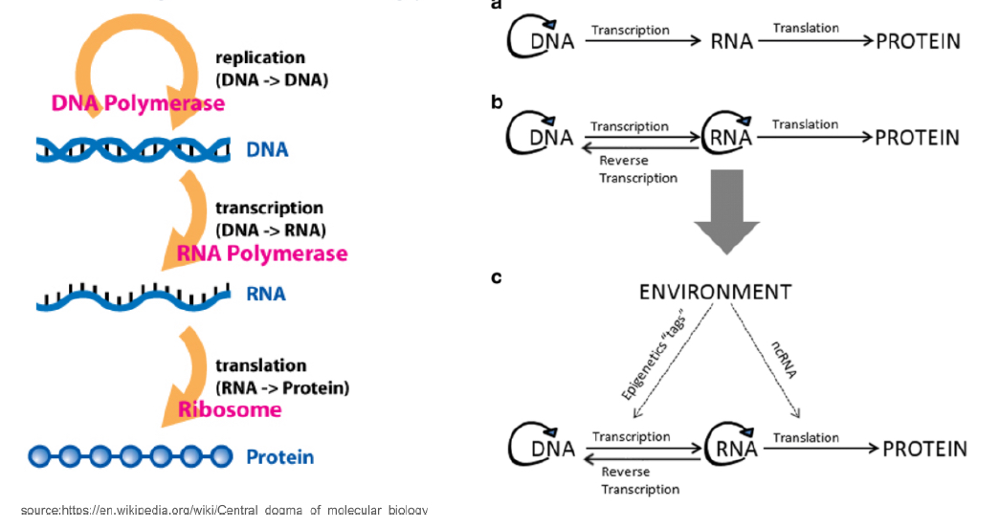
Central Dogma of Biology

Slide 8
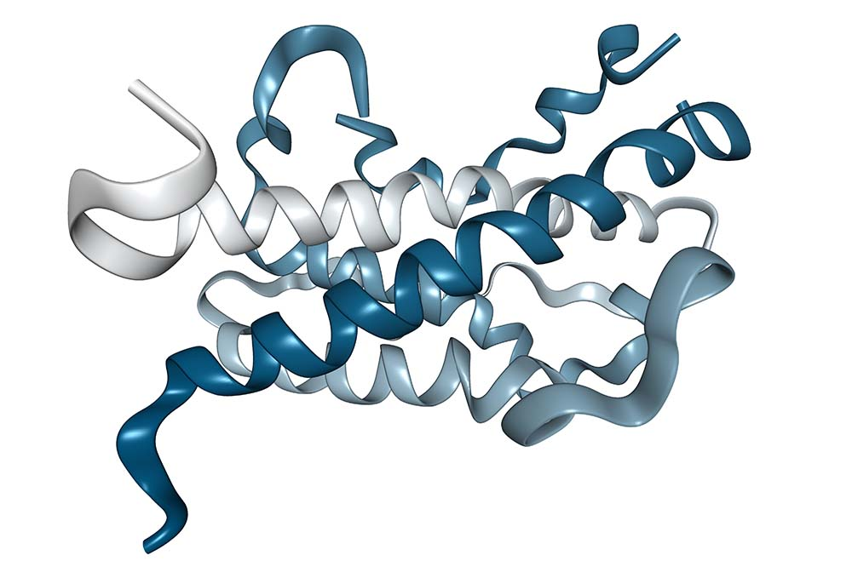
What is Proteome?
The proteome is the entire set of proteins expressed by an organism, cell, or tissue at a specific time and under specific conditions.
It is dynamic and influenced by:
Gene expression patterns.
Environmental conditions.
Developmental stages and disease states.

Slide 9
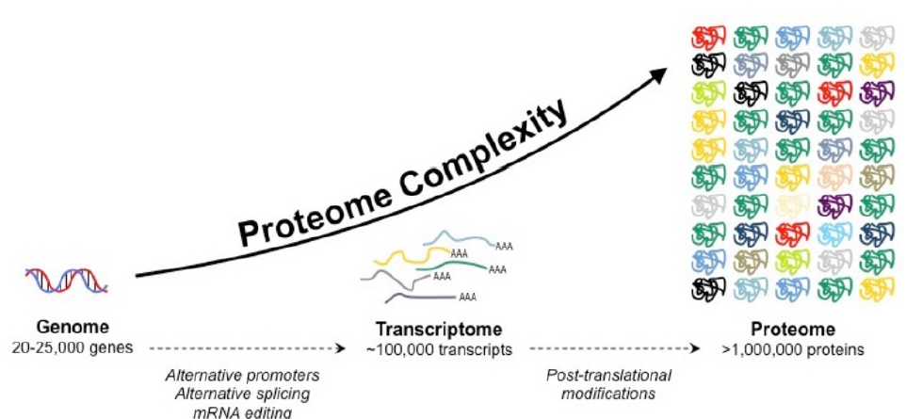
Formation of the Proteome
source:https://old-ib.bioninja.com.au/standard-level/topic-2-molecular-biology/24-proteins/proteome.ht

Slide 10
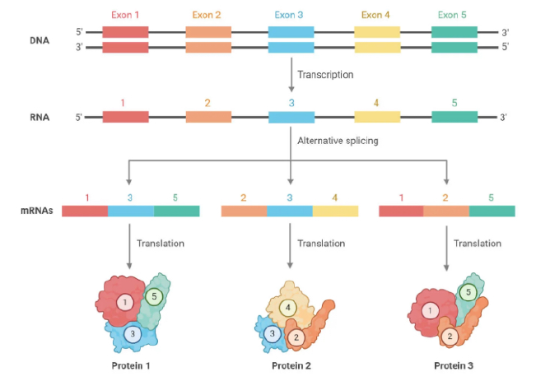
How Alternative splicing increases proteome complexity?
Source: https://microbenotes.com/alternative-splicing/

Slide 11
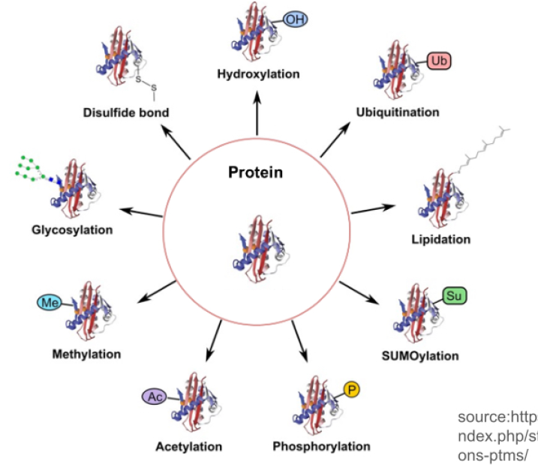
Post-Translational Modifications (PTMs)
PTM refers to the modification that occurs on a protein after translation catalyzed by enzymes.
source:https://www.creative-proteomics.com/blog/i ndex.php/strategies-for-post-translational-modificati ons-ptms/

Slide 12

What is Proteomics?
Proteomics is the large-scale study of proteins, focusing on:
Structure, function, and interactions.
It aims to:
Identify and quantify all proteins in a system.
Understand biological processes and pathways.
Discover biomarkers for diseases or therapeutic targets.

Slide 13
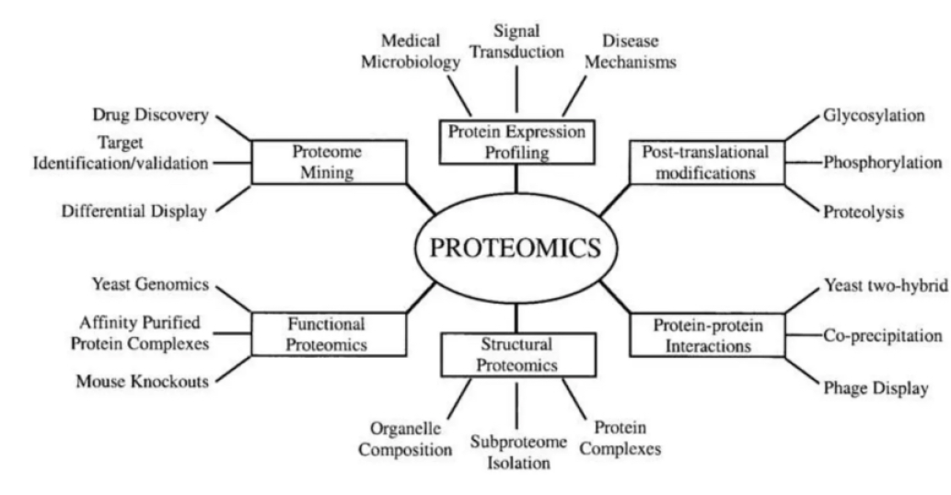
Applications of Proteomics

Slide 14
Three Main Types of Proteomics
Expressional Proteomics
Concerned with the display, measurement and analysis of global changes in protein expressions
Functional Proteomics
Study of protein functions, interactions, and modifications within biological systems to understand their roles in cellular processes, disease mechanisms, and therapeutic applications.
Structural Proteomics
Focuses on determining the three-dimensional structures of proteins and their complexes to understand their functional roles, interactions, and contributions to biological processes.

Slide 15
Three Main Types of Proteomics
Expressional Proteomics
Concerned with the display, measurement and analysis of global changes in protein expressions
Functional Proteomics
Study of protein functions, interactions, and modifications within biological systems to understand their roles in cellular processes, disease mechanisms, and therapeutic applications.
Structural Proteomics
Focuses on determining the three-dimensional structures of proteins and their complexes to understand their functional roles, interactions, and contributions to biological processes.

Slide 16
Why Study Expressional Proteomics?
Understand Disease Mechanisms: Identify how protein expression changes in diseases like cancer or diabetes.
Biomarker Discovery: Detect proteins as diagnostic, prognostic, or therapeutic biomarkers.
Therapeutic Targeting: Uncover proteins that can serve as drug targets.
Personalized Medicine: Correlate protein expression patterns with individual responses to treatments.
Adaptation and Stress Response: Study how organisms respond to environmental stress at the protein level.
Advancing Biotechnology: Improve processes like enzyme engineering or crop
improvement through protein expression insights.

Slide 17
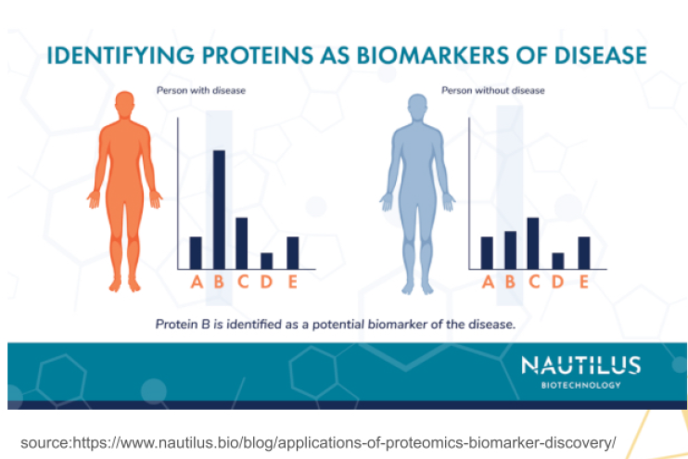
Example Application of Expressional Proteomie Biomarker Discovery in Cancer
Biomarkers-proteins that indicate the presence or
progression of diseases such as cancer. E.g.
Objective: Identify proteins uniquely expressed in cancer cells versus normal cells.
Process: Mass spectrometry and protein
microarrays analyze protein expression in patient samples.
Outcome: Potential biomarkers like PSA for prostate cancer or HER2 for breast cancer, which guide early diagnosis and personalized treatment.
Impact: Enables targeted therapies and improves patient outcomes through precision medicine.

Slide 18
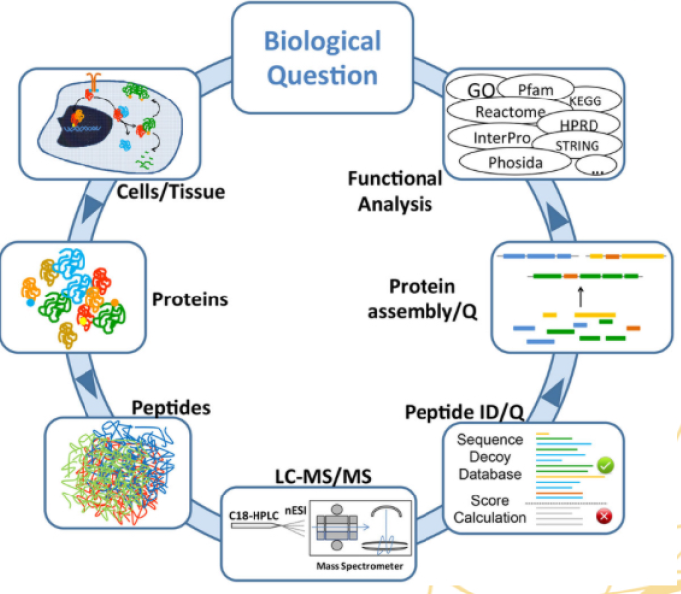
A Generic Proteomics Workflow
Step 1: Sample Preparation: Extract and purify proteins from biological samples.
Step 2: Peptide Separation:
2D-PAGE: Resolves proteins by isoelectric point and molecular weight.
HPLC: Separates proteins/peptides based on their chemical properties.
Step 3: Mass Spectrometry (MS):
Process: Ionizes proteins, detects mass-to-charge ratios, and analyzes data.
Output: Provides protein identification and quantification.
Step 4: Bioinformatics Analysis: Utilizes computational tools to analyze protein data and map pathways, enabling functional insights.

Slide 19
Why Study Functional Proteomics?
Functional proteomics bridges the gap between protein expression and biological roles, enabling deeper insights into health and disease.
Protein Function Insight: Understand how proteins interact and carry out biological roles.
Disease Mechanisms: Study functional disruptions in diseases like cancer and Alzheimer's
Drug Development: Identify and validate therapeutic targets and pathways.
Cellular Pathways: Explore signal transduction and metabolic networks in living organisms.
Precision Medicine: Correlate protein functions with specific patient conditions for tailored therapies.
Dynamic Protein Interactions: Investigate real-time changes in response to environmental or cellular stimuli.

Slide 20
Why Study Functional Proteomics?
Functional proteomics bridges the gap between protein expression and biological roles, enabling deeper insights into health and disease.
Protein Function Insight: Understand how proteins interact and carry out biological roles.
Disease Mechanisms: Study functional disruptions in diseases like cancer and Alzheimer's
Drug Development: Identify and validate therapeutic targets and pathways.
Cellular Pathways: Explore signal transduction and metabolic networks in living organisms.
Precision Medicine: Correlate protein functions with specific patient conditions for tailored therapies.
Dynamic Protein Interactions: Investigate real-time changes in response to environmental or cellular stimuli.

Slide 21
Functional Proteomics Example: Drug Target Identification
Purpose: To find proteins that can be targeted by new medicines.
How it works:
Scientists study how proteins interact with each other in the body (e.g.Yeast-two-hybrid).
They identify specific proteins involved in diseases.
These proteins are tested to see if they can be affected by drugs.
Real-life Example:
In cancer, researchers found a protein called BCR-ABL causing leukemia.
A drug, lmatinib (Gleevec), was developed to block it and successfully treat the disease.
Impact: Functional proteomics helps create targeted treatments, improving patient outcomes.

Slide 22
Protein Interactions
Biological Importance: Understanding PPls and other interactions is essential for drug design, disease mechanisms, and cellular function.
Types:
Protein-Protein Interactions (PPls): Crucial for cellular processes like immune response, and regulation (e.g., enzymes, receptors).
Protein-DNA/RNA Interactions: Important in gene expression, replication, and repair (e.g., transcription factors).
Protein-Ligand Interactions: Enable metabolic processes and regulatory activities (e.g., hormones binding to receptors).

Slide 23
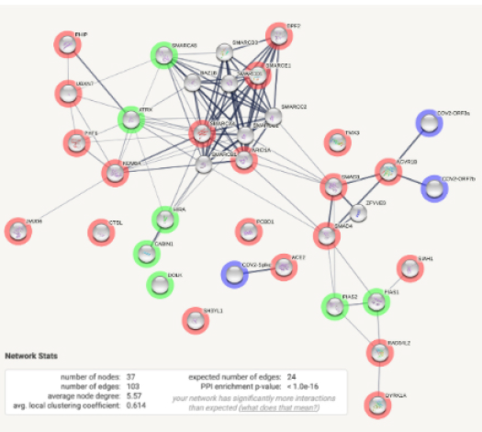
How to identify PPls?
1. Experimental Techniques:
Yeast Two-Hybrid (Y2H): Detects physical interactions in living cells.
Co-lmmunoprecipitation (Co-IP): Pulls down interacting proteins using specific antibodies.
Mass Spectrometry (MS): Identifies interaction partners in protein complexes.
Computational Methods:
Docking Algorithms: Predicts interaction interfaces.
Text Mining: e.g. the STRING database

Slide 24
Why Study Structural Proteomics?
Structural proteomics is vital for deciphering the molecular mechanisms underlying biological functions and therapeutic innovations.
Understand 3D Protein Architecture: Reveals how protein structures enable their function.
Disease Insight: Identifies structural changes in proteins associated with diseases.
Drug Discovery: Assists in designing molecules that fit specific protein targets (e.g., inhibitors, activators).
Protein-Protein Interactions: Explores binding interfaces for complex formation and signal transduction.
Functional Correlation: Links structure with biological roles and cellular mechanisms.
Evolutionary Studies: Analyzes structural conservation and variations across species.

Slide 25
Structural Proteomics Example: Understanding Disease Mechanisms
Purpose: To study the 3D shapes of proteins and understand how they contribute to diseases.
How it works:
Scientists analyze protein structures to understand how they work in the body.
Structural information helps in discovering how proteins malfunction in diseases like Alzheimer's or cancer.
By understanding these structures, they can develop drugs that specifically target abnormal proteins.
Real-life Example:
Alzheimer's Disease:
Structural proteomics helped reveal the structure of amyloid-beta plaques (protein clumps in the brain).
This led to research on therapies aimed at preventing plaque formation, which is linked to the disease's progression.
Impact:
Structural proteomics plays a crucial role in drug discovery by providing detailed protein structures, enabling the development of more precise treatments.

Slide 26
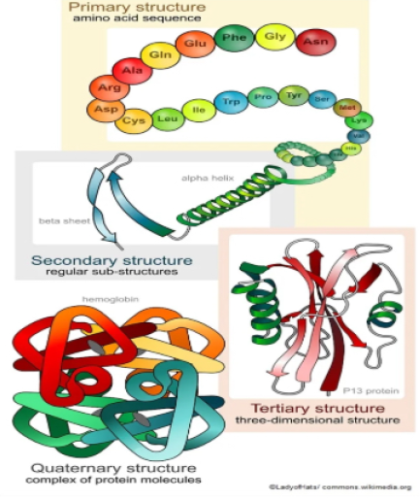
Protein Structure
Primary: the exact ordering of amino acids forming their chains.
Secondary: local folded structures that form within a polypeptide due to interactions between atoms of the backbone.
Tertiary: represents overall folding of the polypeptide chains, further folding of the secondary structure.
Quaternary: the spatial arrangement of various tertiary structures gives rise to the quaternary structure.
source:https://www.news-medical.neUlife-sciences/Protein-Structl.Jre-and-Function.aspx

Slide 27
Protein structure determines function
Each protein has a unique sequence of amino acids, and the interactions among these amino acids determine its specific shape.
This shape is crucial for the protein's function, whether it's digesting food in the stomach or transporting oxygen in the blood.

Slide 28
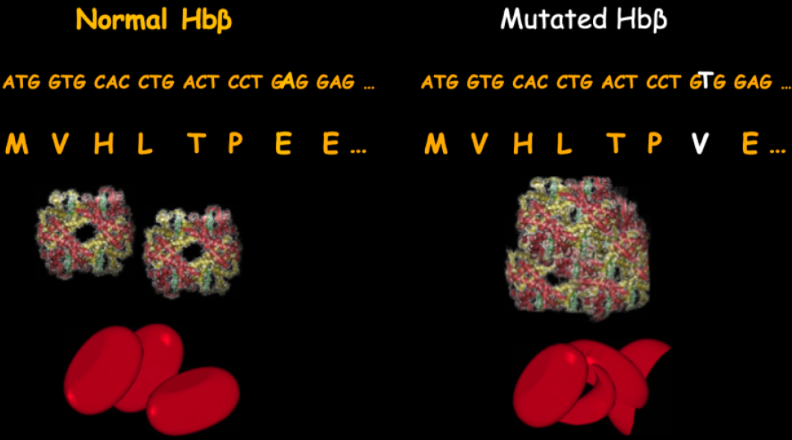
Sickle Cell Disease is caused by single amino acid change
Source: https://slideplayer.com/slide/7042803/

Slide 29
How to predict protein function?
Understanding protein function is key to drug development, disease research, and biotechnology.
Experimental Methods:
Mutagenesis Studies: Alter genes to observe changes in protein function.
Biochemical Assays: Test enzymatic activities or binding properties.
Localization Studies: Use techniques like fluorescence microscopy to determine where the protein works.
Bioinformatics Approaches:
Sequence Analysis: Compare to known proteins using BLAST.
Structure-Function Relationship: Predict function based on 30 structure.
Databases: Use UniProt or Pfam to access functional annotations.
Omics Studies:
Transcriptomics and proteomics link expression levels to biological roles.

Slide 30
Protein data

Slide 31
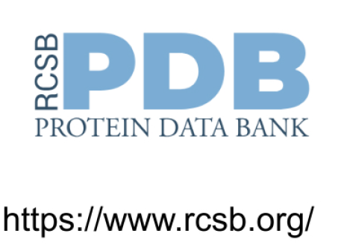
Protein Structure - Protein DataBank
A global database for storing 3D structural data of biological molecules like proteins, DNA, and RNA.
Provides atomic-level details for research in biology, drug design, and bioinformatics.
Helps visualize molecular structures and their interactions.
Contains experimentally validated entries

Slide 32

Protein sequences and functions: UniProt Knowledge Base
UniProt is the world's leading high-quality, comprehensive and freely accessible resource of protein sequence and functional information.
Around 250 Million protein sequences
More than 550 thousand reviewed and manually annotated proteins

Slide 33
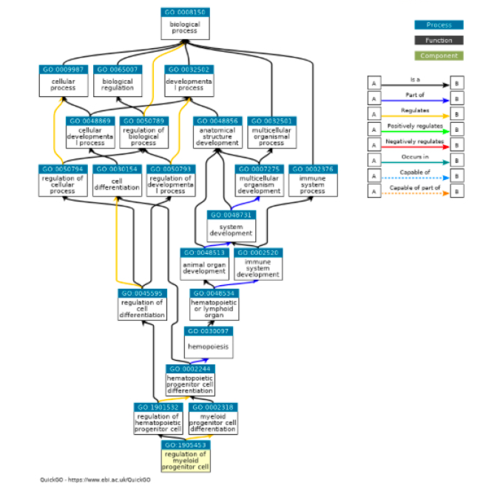
Classification of Protein Functions - Gene Ontology
Biological Process - processes to which gene or gene product contributes
Molecular Function - biochemical activity of a gene product
Cellular Component - location of a gene product where it is active

Slide 34

lnterPro: Protein Families and Domains
lnterPro provides functional analysis of proteins by classifying them into families and predicting domains and important sites.

Slide 35
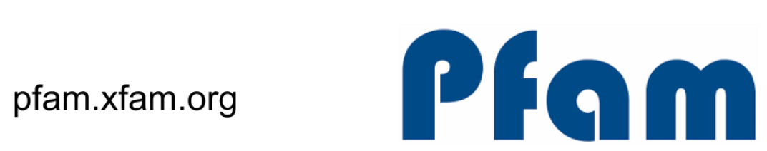
Protein families and functions: Pfam
Focuses on functional annotation of protein sequences by identifying conserved domains and families.
Uses computational methods for high-accuracy predictions.
Essential for understanding protein roles and evolutionary relationships

Slide 36
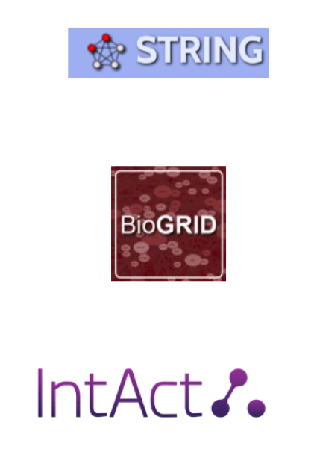
PPls: STRING, BioGRID, lntAct
STRING:
Integrates known and predicted protein-protein interactions.
Includes direct (physical) and indirect (functional) associations.
string-db.org
BioGRIO:
A curated database of physical and genetic interactions.
Focuses on experimentally verified data.
thebiogrid.org
lntAct:
Provides detailed interaction data, including experimental conditions.
Allows network visualization and analysis.
ebi.ac.uk/intact

Slide 37
Day 4: Proteomics and Structural Bioinformatics Practical Morning Session

Slide 38
Hands-on: Basic Proteomics Exercises

Slide 39
Day 4: Proteomics and Structural Bioinformatics Afternoon Session

Slide 40
Introduction to Structural Bioinformatics

Slide 41
What is Structural Bioinformatics?
Computational methods to study the 3D structures of proteins and nucleic acids, combining biology, chemistry, physics, and computer science to predict and analyze molecular structures

Slide 42
Applications of Structural Bioinformatics
Accelerates precision medicine, improves biomolecular design, and advances our understanding of life at the molecular level.
Drug Discovery: Design and optimization of small molecules, vaccines, and antibody therapeutics.
Protein Engineering: Designing enzymes, improving stability, and creating novel functions.
Disease Mechanisms: Understanding molecular basis of diseases and identifying potential therapeutic targets.
Functional Annotation: Predicting functions of uncharacterized proteins using structural information.
Evolutionary Studies: Exploring protein evolution and phylogenetics.

Slide 43
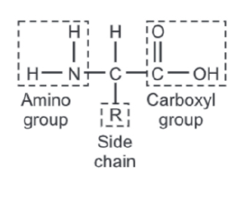
What is protein structure?
Protein structure refers to the three-dimensional arrangement of amino acids in a protein molecule.
Functionality: A protein's structure determines its role in biological processes, such as enzyme activity or signaling.
Specificity: Small changes in structure (e.g., misfolding) can lead to diseases like Alzheimer's or cystic fibrosis.

Slide 44
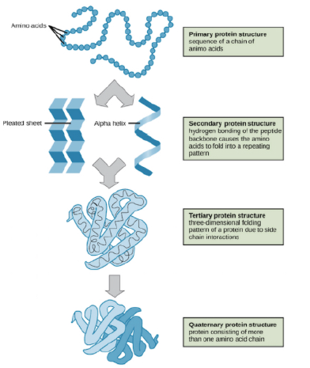
Structural levels of proteins (Hierarchical)
source:https://biologyease.com/protein-structur1;1s/#google_vignette

Slide 45
Levels of protein structure: Primary Structure
A protein's primary structure refers to the amino acid sequence of its polypeptide chain.
MFVFLVLLPLVSSQCVNLTTRTQLPPAYTNSFTRGVYYPDKVFRSSVLHSTQDLFLPFFSNVTWFHAIHVSGTNGTKRFDNPVLP FNDGVYFASTEKSNIIRGWIFGTTLDSKTQSLLIVNNATNVVIKVCEFQFCNDPFLGVYYHKNNKSWMESEFRVYSSANNCTFEY VSQPFLMDLEGKQGNFKNLREFVFKNIDGYFKIYSKHTPINLVRDLPQGFSALEPLVDLPIGINITRFQTLLALHRSYLTPGDSS SGWTAGAAAYYVGYLQPRTFLLKYNENGTITDAVDCALDPLSETKCTLKSFTVEKGIYQTSNFRVQPTESIVRFPNITNLCPFGE VFNATRFASVYAWNRKRISNCVADYSVLYNSASFSTFKCYGVSPTKLNDLCFTNVYADSFVIRGDEVRQIAPGQTGKIADYNYKL PDDFTGCVIAWNSNNLDSKVGGNYNYLYRLFRKSNLKPFERDISTEIYQAGSTPCNGVEGFNCYFPLQSYGFQPTNGVGYQPYRV VVLSFELLHAPATVCGPKKSTNLVKNKCVNFNFNGLTGTGVLTESNKKFLPFQQFGRDIADTTDAVRDPQTLEILDITPCSFGGV SVITPGTNTSNQVAVLYQDVNCTEVPVAIHADQLTPTWRVYSTGSNVFQTRAGCLIGAEHVNNSYECDIPIGAGICASYQTQTNS PRRARSVASQSIIAYTMSLGAENSVAYSNNSIAIPTNFTISVTTEILPVSMTKTSVDCTMYICGDSTECSNLLLQYGSFCTQLNR ALTGIAVEQDKNTQEVFAQVKQIYKTPPIKDFGGFNFSQILPDPSKPSKRSFIEDLLFNKVTLADAGFIKQYGDCLGDIAARDLI CAQKFNGLTVLPPLLTDEMIAQYTSALLAGTITSGWTFGAGAALQIPFAMQMAYRFNGIGVTQNVLYENQKLIANQFNSAIGKIQ DSLSSTASALGKLQDVVNQNAQALNTLVKQLSSNFGAISSVLNDILSRLDKVEAEVQIDRLITGRLQSLQTYVTQQLIRAAEIRA SANLAATKMSECVLGQSKRVDFCGKGYHLMSFPQSAPHGVVFLHVTYVPAQEKNFTTAPAICHDGKAHFPREGVFVSNGTHWFVT QRNFYEPQIITTDNTFVSGNCDVVIGIVNNTVYDPLQPELDSFKEELDKYFKNHTSPDVDLGDISGINASVVNIQKEIDRLNEVA KNLNESLIDLQELGKYEQYIKWPWYIWLGFIAGLIAIVMVTIMLCCMTSCCSCLKGCCSCGSCCKFDEDDSEPVLKGVKLHYT

Slide 46
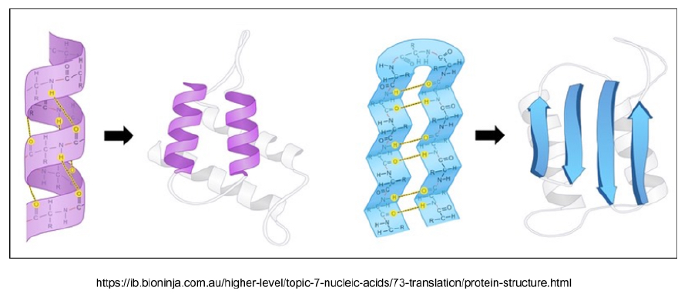
Levels of protein structure: Secondary Structure
A secondary structure is a repeating substructure that forms as a substructure of the overall folded protein.

Slide 47
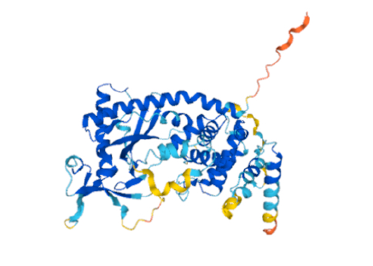
Levels of protein structure: Tertiary Structure (3D)
A protein's tertiary structure describes its final 3D shape after the polypeptide chain has folded and is chemically stable. This is what we most commonly refer to as the "structure" of a protein.

Slide 48
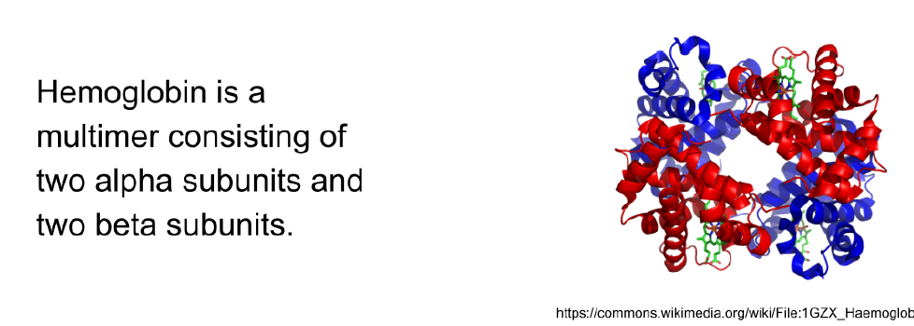
Levels of protein structure: Quaternary Structure
Some proteins have a quaternary structure, which describes the protein's interaction with other copies of itself to form a single functional unit, or a multimer.

Slide 49
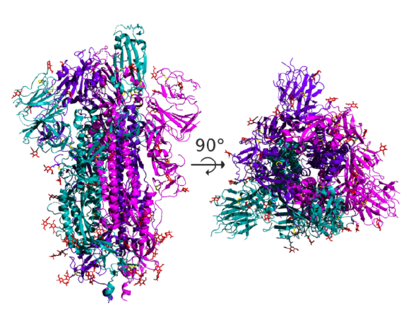
Example: Spike protein
The spike protein is a homotrimer, formed of three essentially identical units called chains, each one translated from the same genome region.

Slide 50
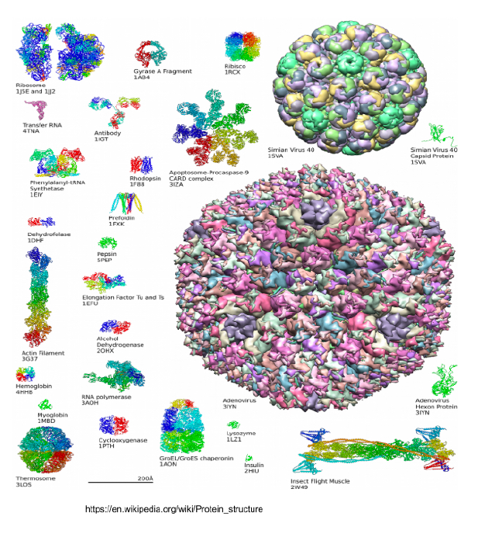
Proteins come in all different shapes

Slide 51
How do we determine protein structure?
Experimental Methods:
X-ray Crystallography: Determines atomic structure via X-ray diffraction from protein crystals.
NMR Spectroscopy: Uses magnetic fields to study proteins in solution.
Cryo-Electron Microscopy: Visualizes proteins at near-atomic resolution without crystallization.
Computational Methods:
Homology Modeling: Predicts structure based on known templates.
Molecular Dynamics: Simulates atomic interactions.
Deep Learning Models: Tools like AlphaFold predict structures using Al by learning patterns from large datasets of protein structures.

Slide 52
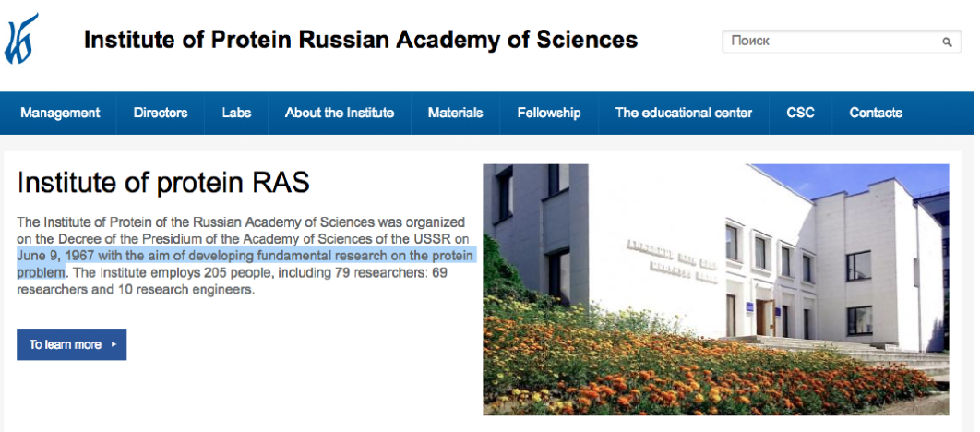
The Russian Academy of Sciences' Protein Institute has been tackling this challenge for over 50 years!

Slide 53
Can we discover the structure of all proteins experimentally?
The required electron microscope costs over $SM and is expensive to operate.
Humans alone have between 600,000 and 6 million isoforms!
Small changes in the primary sequence can significantly alter the structure.
Determining the structure of all proteins experimentally is impossible!

Slide 54
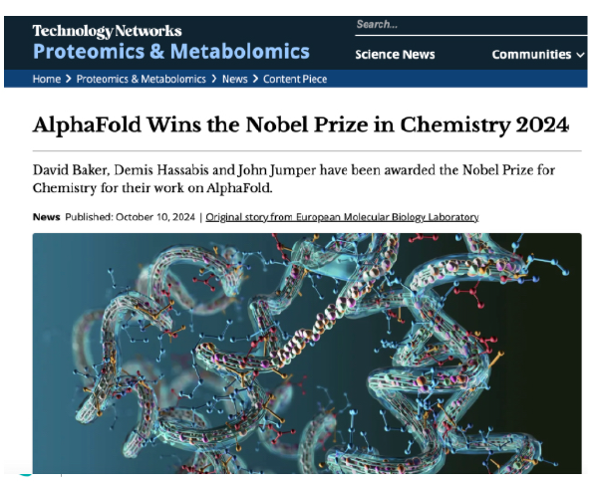
How do we determine protein structure computationally?
AlphaFold3 is an advanced Al model by DeepMind that predicts the 3D structures of proteins, nucleic acids, small molecules, and post-translational modifications with high accuracy.
It also supports multi-chain predictions, making it suitable for cofolding and docking applications.

Slide 55
Experimental vs Computational Methods
Experimental methods are highly accurate but time-consuming
Computational methods like AlphaFold offer faster, scalable predictions for unknown structures.

Slide 56
Hands on
Predict protein structure with AlphaFold2:

Slide 57
Practice for Exam

Slide 58
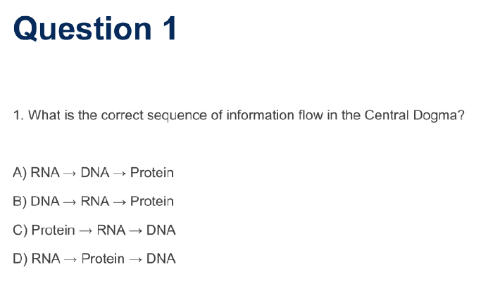

Slide 59
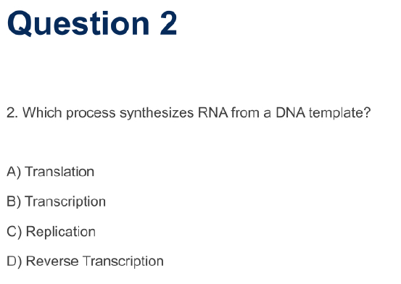

Slide 60
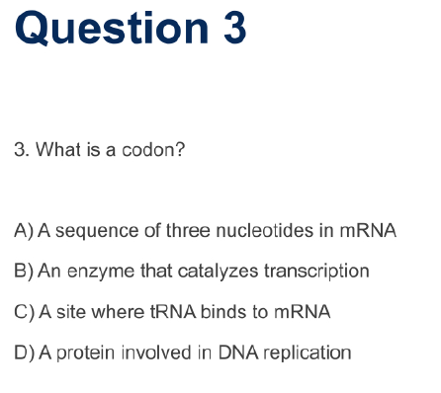

Slide 61
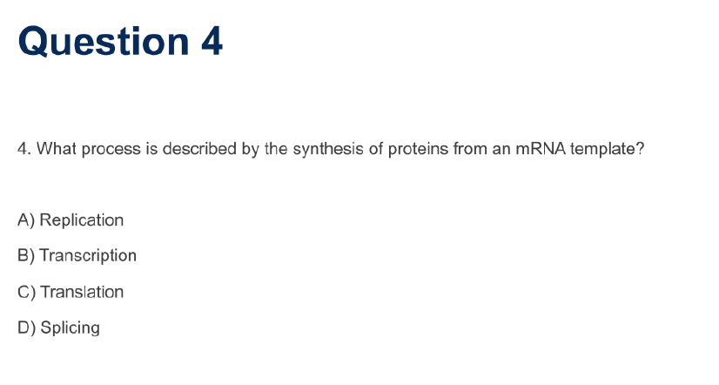

Slide 62
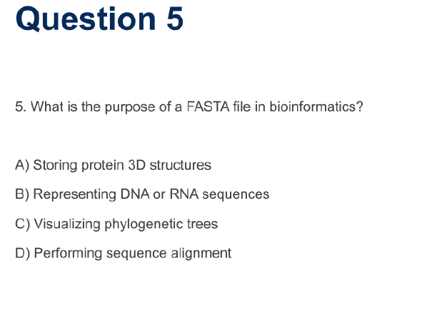

Slide 63
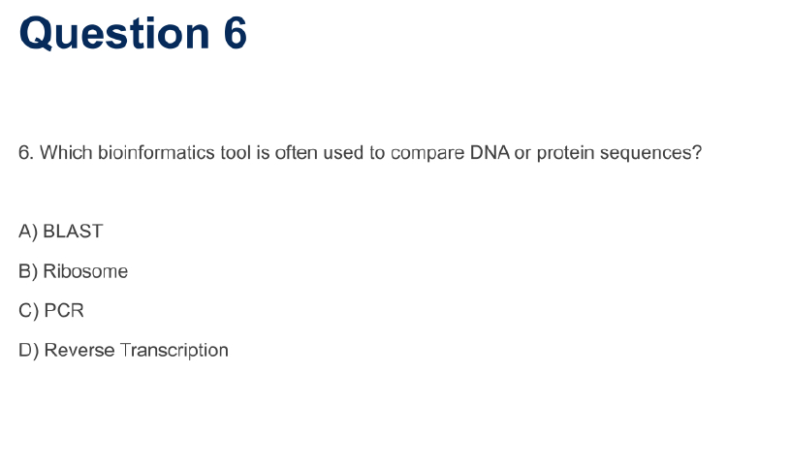

Slide 64
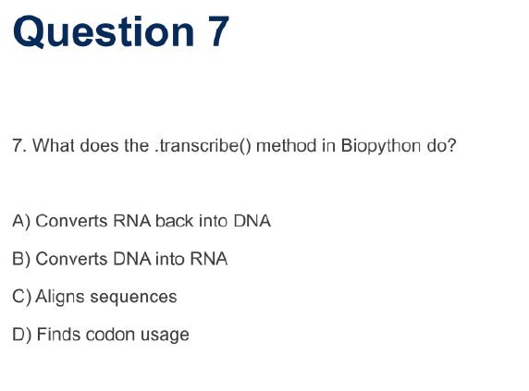

Slide 65
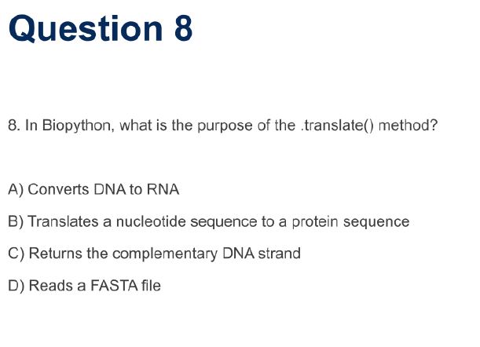

Slide 66
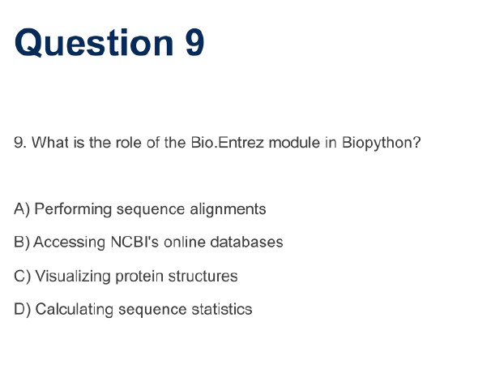

Slide 67
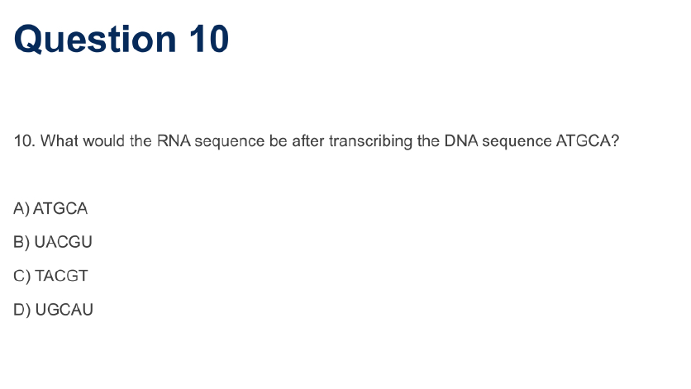

Slide 68
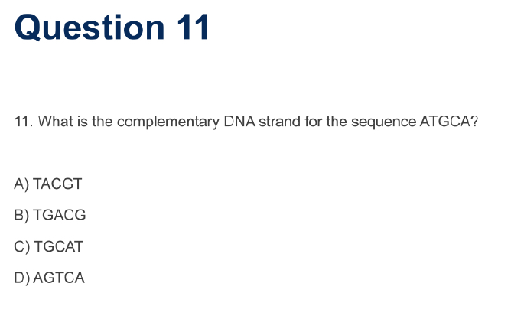

Slide 69
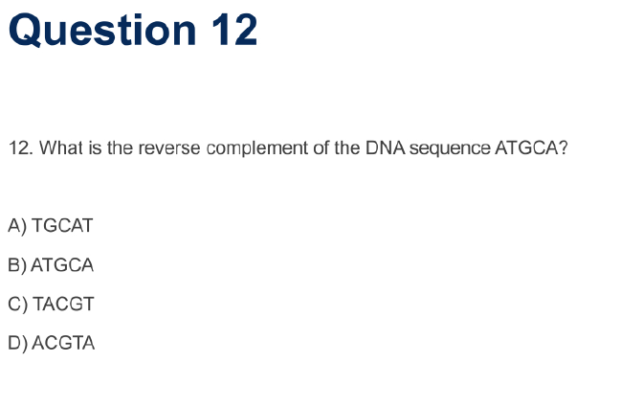

Slide 70
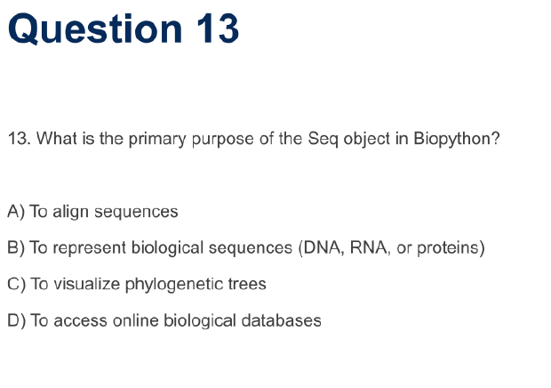

Slide 71
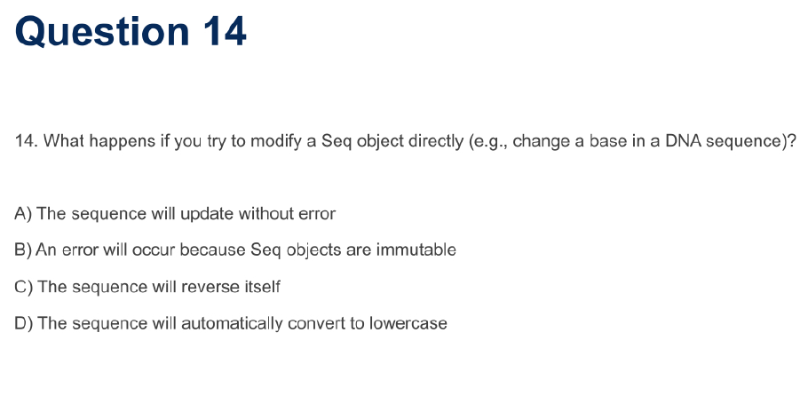

Slide 72
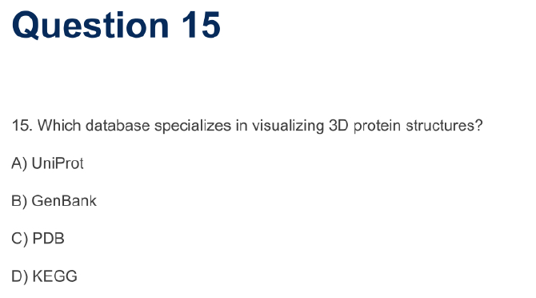

Slide 73
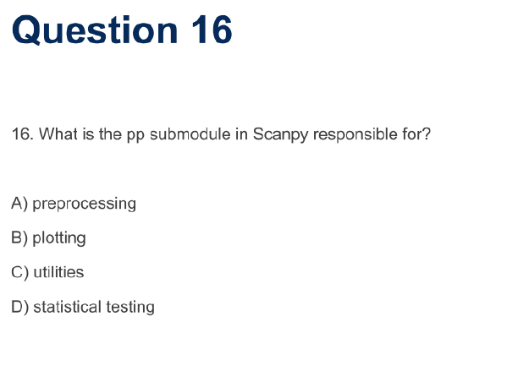

Slide 74
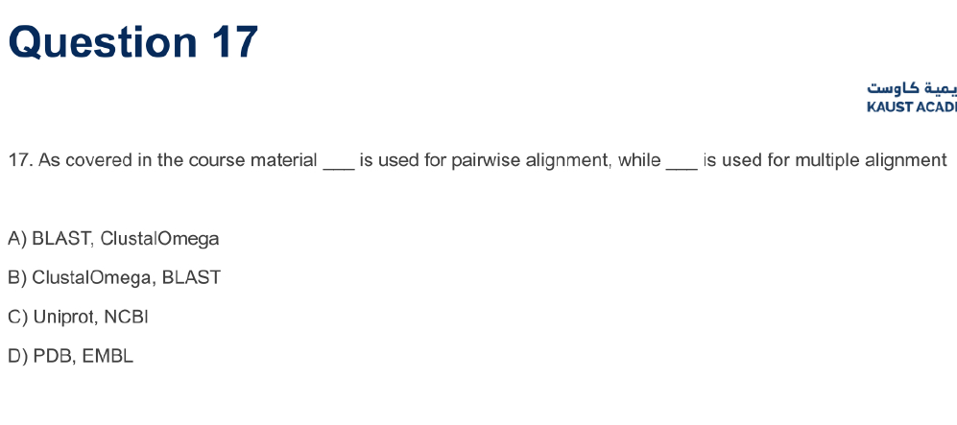

Slide 75
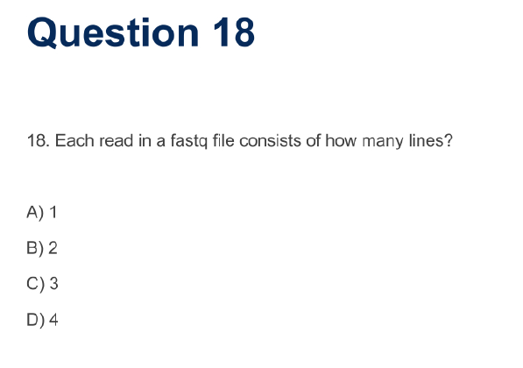

Slide 76
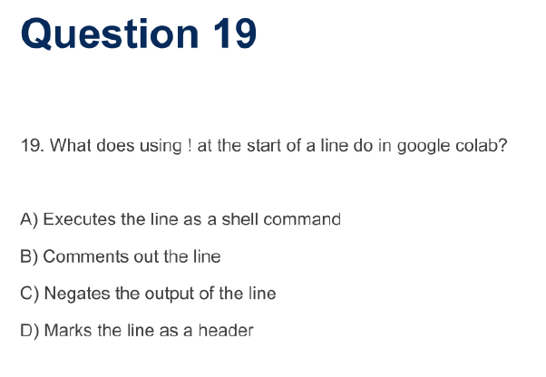

Slide 77
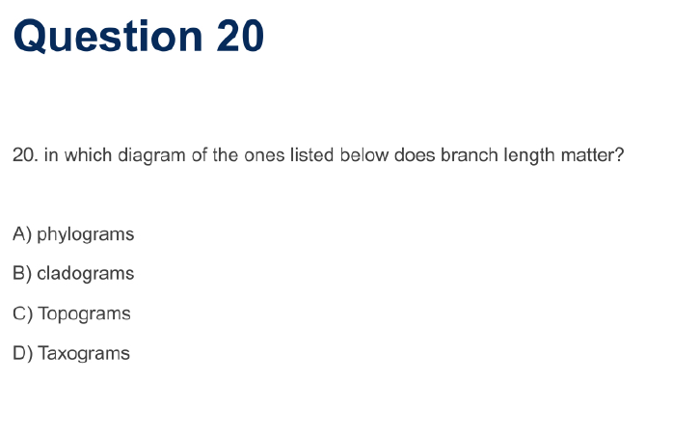

Slide 78
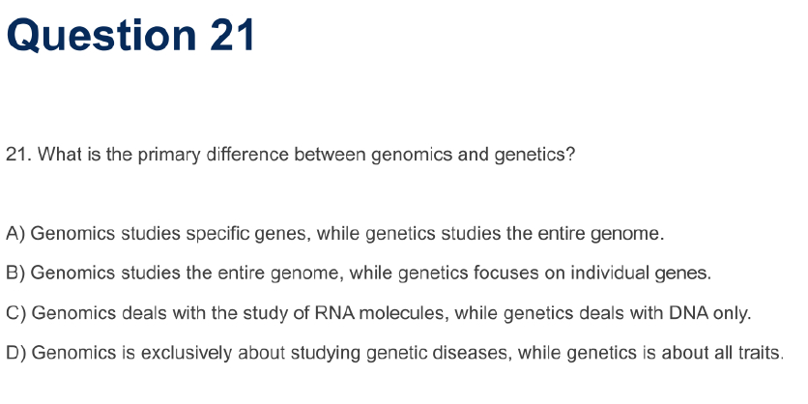

Slide 79
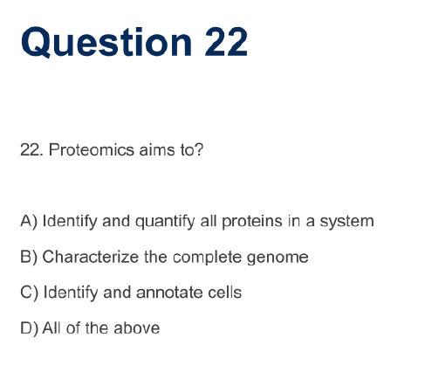

Slide 80
